Slide 1

Lecture 7 Datalogger Programming Using Arduino – Part 2
Jeffery S. Horsburgh
Hydroinformatics
Fall 2016
This work was funded by National Science Foundation Grants EPS 1135482 and EPS 1208732

Slide 2
Objectives
Learn basic data collection concepts for hydrologic data
Examine more closely observation dimensionality, including the scale triplet of support, spacing, and extent
Learn the basic datalogger program structure for logging data

Slide 3
How do we turn an Arduino into a datalogger?
Some things we have to figure out:
Debugging
Timing
Interfacing with sensors and making measurements
Recording data to a file

Slide 4
Let’s Add a Sensor
AM2302 (wired version of the DHT22)
Measures temperature and relative humidity
Accuracy
Temperature: +- 0.5 Deg. C
Relative Humidity: +- 2% RH
For $15 it’s an OK sensor
Unfortunately, it’s SLOW – can only get new measurements every 2 seconds
https://cdn-shop.adafruit.com/datasheets/Digital+humidity+and+temperature+sensor+AM2302.pdf

Slide 5
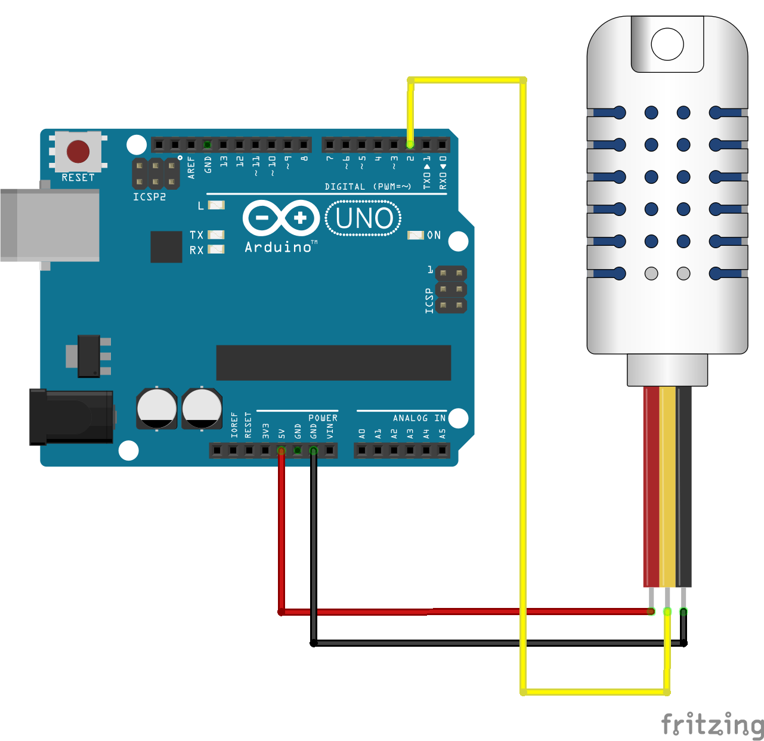
Wiring
Red → +5V
Black → Ground
Yellow → Digital Pin 2

Slide 6
Environmental Sensors
Purpose is to detect events or changes in the environment and provide a corresponding output – usually electrical or optical
Signal is interpreted by or transmitted to a datalogger
Analog
A continuous voltage output proportional to the value of the observed variable
Datalogger must interpret the result
Digital
Sensor does all signal processing
Reports a result encoded as a digital signal to the datalogger

Slide 7
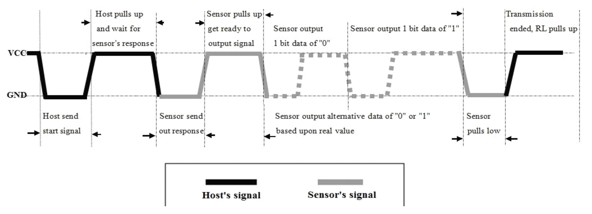
Communications
The AM2302 is a digital sensor
1 wire digital bus
Complicated – and requires precise timing

Slide 8
Arduino Libraries
Arduino code functions written by others with functionality that you may want to reuse
The AM2302/DHT22 sensor has a library that we can use: https://github.com/adafruit/DHT-sensor-library
Useful functions:
readHumidity()
readTemperature()
convertCtoF()
convertFtoC()
computeHeatIndex()

Slide 9
Arduino Library Download and Install
Use the Arduino IDE Library Manager
Details: https://www.arduino.cc/en/Guide/Libraries
Click on the “Sketch” menu then “Include Library → Manage Libraries”

Slide 10
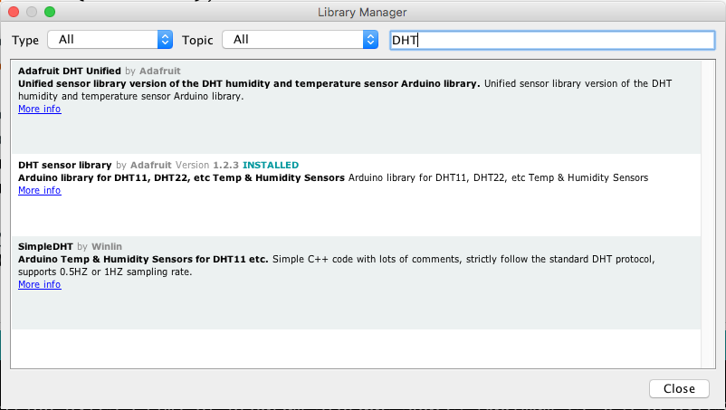
Arduino Library Manager
2. Select the Library and Click “Install”
1. Search for ”DHT”

Slide 11
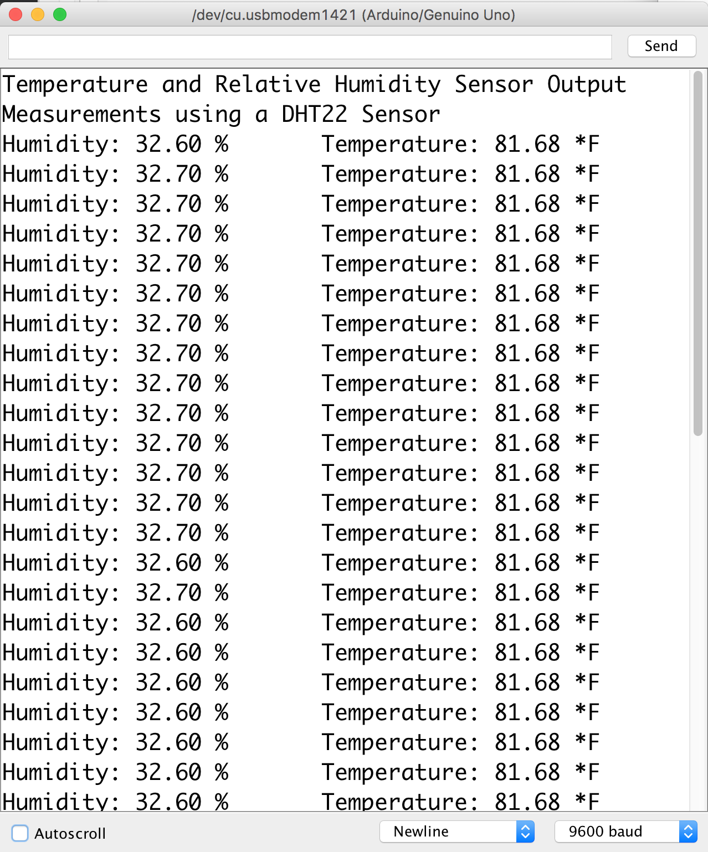
Testing the Sensor – “Measurement_Example” Sketch
Red → +5V
Black → Ground
Yellow → Digital Pin 2

Slide 12
How do we turn it into a datalogger?
Some things we have to figure out:
Debugging
Timing
Interfacing with sensors and making measurements
Recording data to a file

Slide 13
Recording Data to a File
The Arduino UNO has no data recording capability
You can output to a serial monitor and capture that as a file
Requires your computer to be deployed with the Arduino and sensor (not ideal)
The answer – add a MicroSD Card Breakout board!
MicroSD Card provides GB of storage for files
Supports extended deployments

Slide 14
SD Card Library for Arduino
Already installed by default
Enables reading and writing contents of an SD or MicroSD card
Examples of use: https://learn.adafruit.com/adafruit-micro-sd-breakout-board-card-tutorial/library

Slide 15
Some Notes on the MicroSD Cards
They are strictly 3.3 volt devices!
SD cards are raw storage, but can be formatted with a file system
The SD cards in your kit should work with Arduino, Windows, and Mac (but some devices require a specific file system)
Don’t format unless you use the “official” formatter from: https://www.sdcard.org/downloads/formatter_3/
FAT32 is a good option for the file system

Slide 16
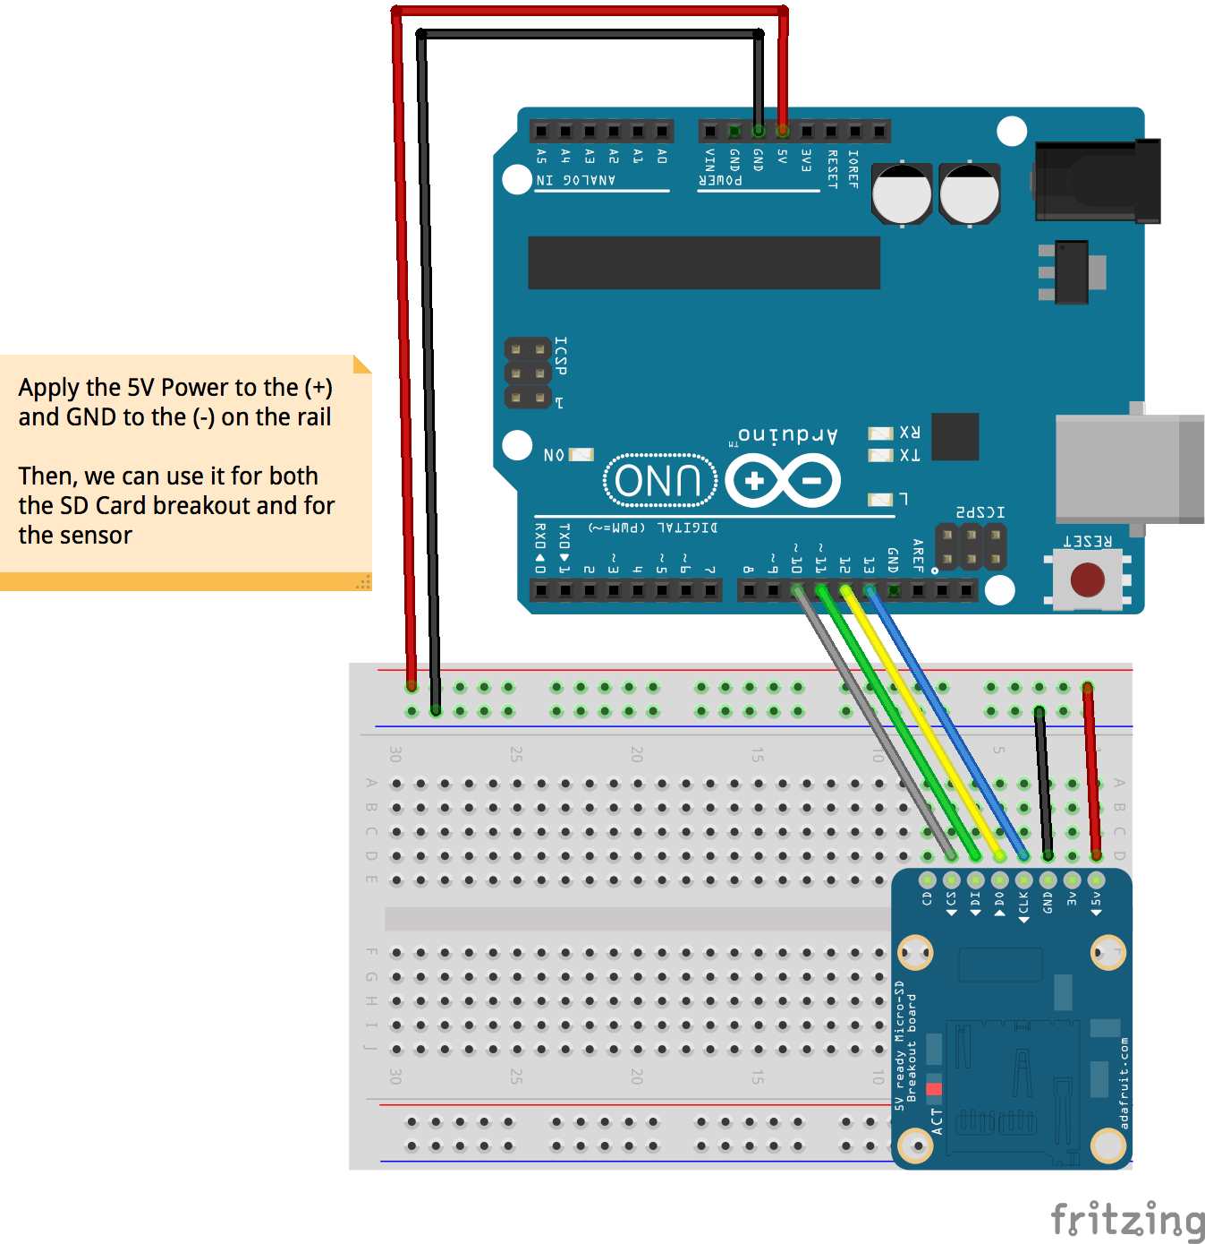
Micro SD Breakout Wiring
Breakout CS --> Arduino Digital Port 10
Breakout DI --> Arduino Digital Port 11
Breakout DO --> Arduino Digital Port 12
Breakout CLK --> Arduino Digital Port 13
Breakout GND --> Arduino GND
Breakout 5V --> Arduino 5V

Slide 17
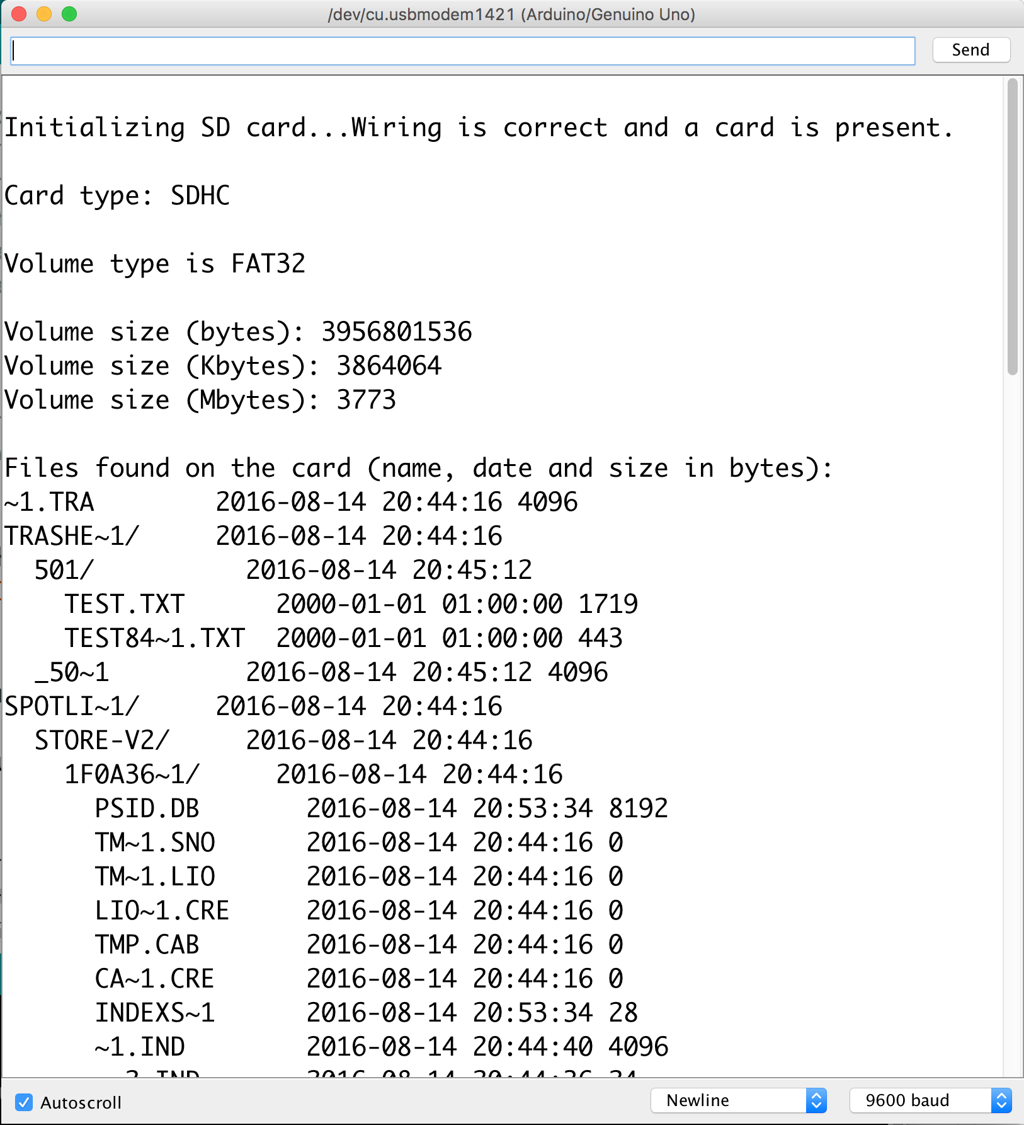
Testing the SD Card – “SD_CardInfo” Sketch
Wire up the SD Card breakout
Open the “SD_CardInfo” sketch in the IDE
Load it onto the Arduino
Open your serial monitor
Should give you some diagnostic information about your SD Card
Useful for testing SD cards

Slide 18
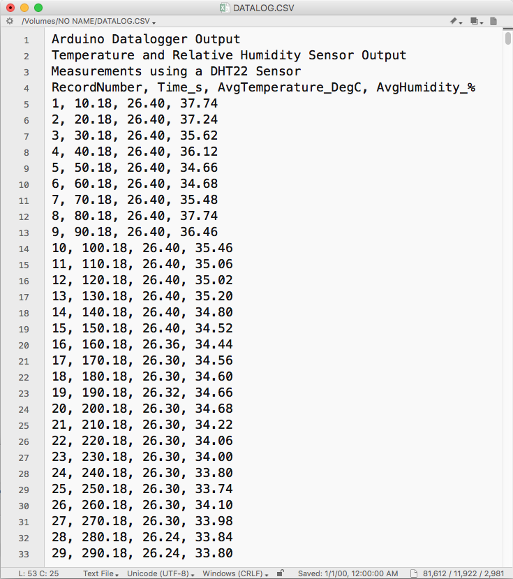
What should our output data file look like?
A descriptive
header
Column
headings
Comma separated values (CSV)

Slide 19
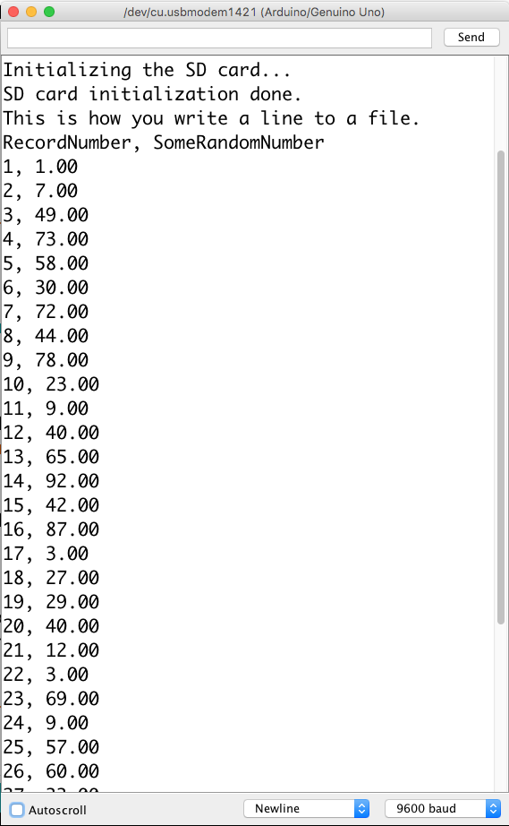
Create a file and write some data “SD_Write_Example” Sketch
Pseudo Code
In the setup() function:
Open a serial port
Initialize the SD card
Open a file
Write a couple of header lines
Close the file
In the loop() function
Open the file
Create a string with random values to write as a line to the file
Print the string to the file
Close the file
Delay for 2 seconds

Slide 20
How do we turn it into a datalogger?
Some things we have to figure out:
Debugging
Timing
Interfacing with sensors and making measurements
Recording data to a file
You’ve got all the pieces you need now

Slide 21
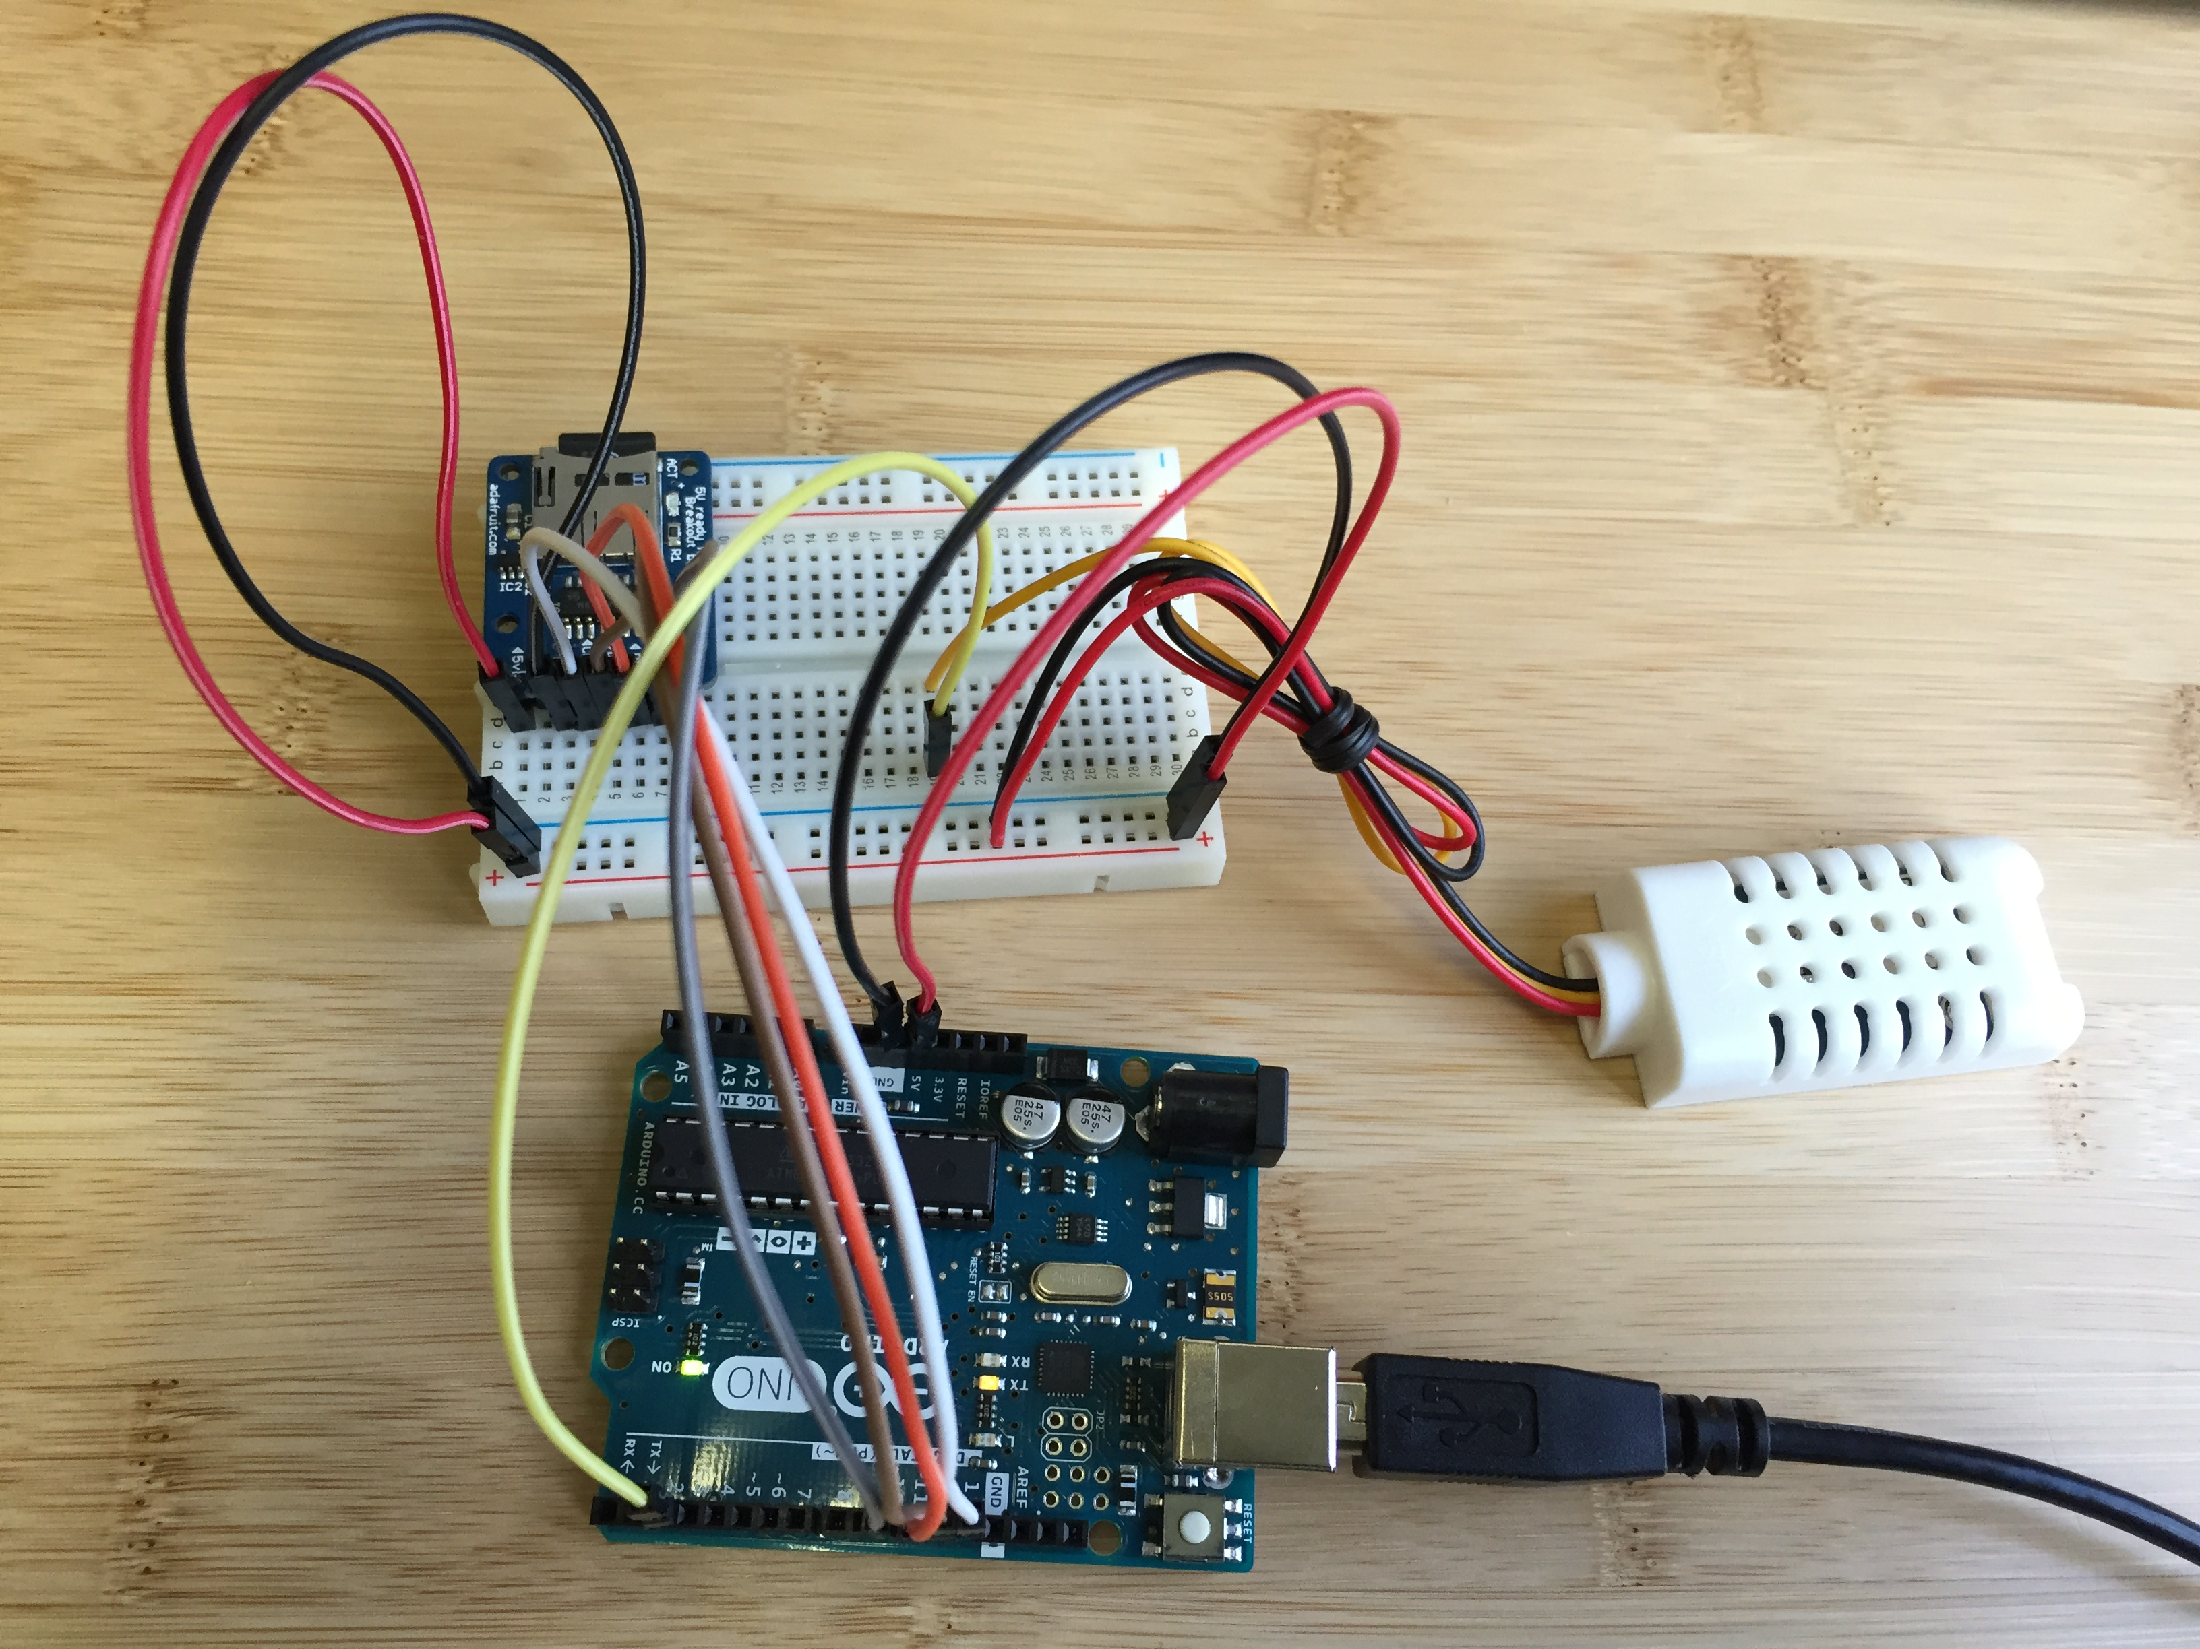
It will look something like this…

Slide 22
Summary
Interfacing Arduino (and other dataloggers) with sensors may be analog or digital
Arduino libraries can be imported into sketches to extent functionality (e.g., for working with sensors)
Arduinos can write to external SD storage
SD cards provide a ton of space for files
Relatively simple library provides functions for creating files, reading files, writing to files
You should think carefully about the format of your file in planning for data collection (header, column headings, data structure, etc.)

